Slide 1
eCityGov Alliance
Executive Board Meeting
April 5, 2019

Slide 2

Agenda
Approve agenda and February minutes
Executive Director Monthly Update March 2019
Final language for Administrative Policies
Cyber security agreement longer-term path
RESOLUTION to approve Woodway subscriber agreement
Media article update
RESOLUTION to approve new board officer rotation
Budget & Finance Updates
2019 work plan and eCheck project update
Business development update and MBP map
Adding non-traditional subscribers
Alliance staff changes and ideas
Visioning work and workshop framing
B&O Tax System of Record opportunity

Slide 3
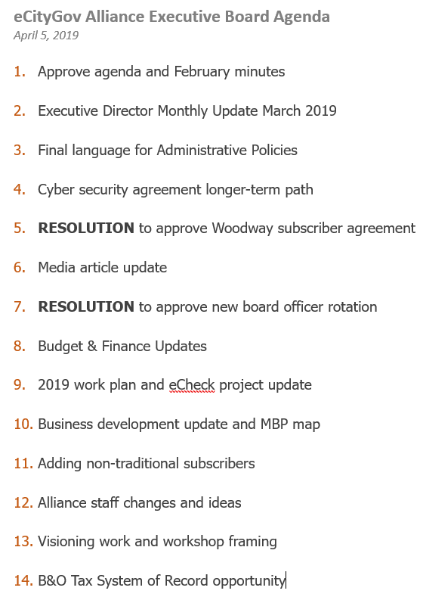
Approve Agenda and February Minutes
April 5th Agenda Changes
?
?
?
?
February Minutes & Follow Ups
?
?
?
?

Slide 4
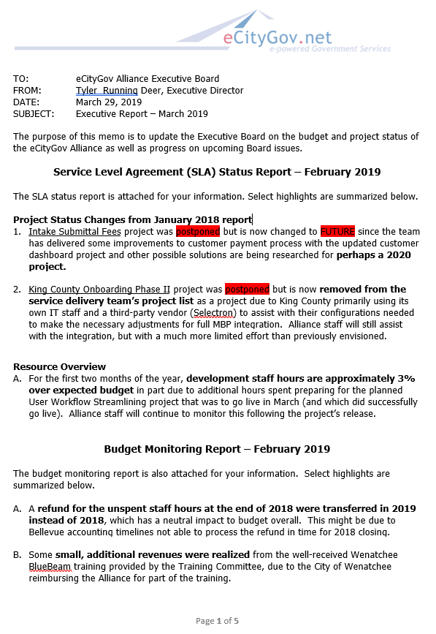
Executive Director Monthly Update
March 2019
Update Memo Sections
Service Level Agreement (SLA) Status Report – February 2019
Budget Monitoring Report – February 2019
Executive Board Planning – April 2019
Alliance Committee Activities – March 2019
Business Development – March 2019
General Activities – March 2019
Feedback

Slide 5

Final Language for
Administrative Policies
Management Committee Feedback
Board changes are appropriate approach for each jurisdiction
Not too different from current practices for other code issues
All “participating” jurisdiction agreement is too many (18 currently)
Recommend changing to agreement for just principals (6 currently)
Change
Goals
  To achieve these goals, the Committee will:
    Monitor State code and legislation, and work with individual jurisdictions to learn of potential impacts of pending legislation. If all participating principal jurisdictions approve one or more proposed responses, then a joint response could be proposed to the Alliance Board for collective action.

Slide 6

Cyber Security Agreement
Longer-Term Path
Background
Woodway interested in becoming subscriber
Old employee attachment not relevant nor encompassing
Board requested new attachment
Follow ups
Reviewed Snoqualmie template and Bellevue current policies
Consulted with Legal Counsel, PJ Rodriguez and John Traeger
Concerns about needing more time to “get it right”
Action Steps
Draft attachment with subcommittee and Legal
Bring to future Executive Board meeting for discussion
Proposal for how to roll out approved attachment

Slide 7
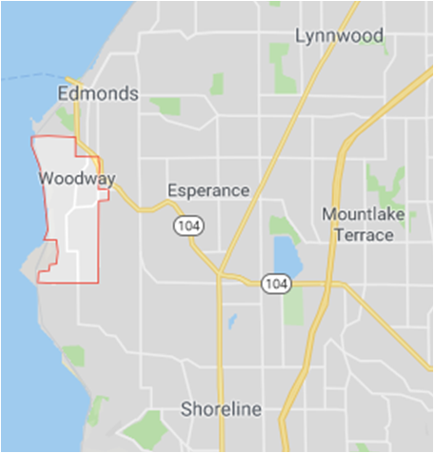
RESOLUTION to Approve Woodway Subscriber Agreement
Jurisdiction Statistics
Within Snohomish County
Incorporated in 1958 to protect heavy forest area
2010 US Census reported 1,307 residents
Average annual permit revenue is approximately $73,000
http://www.townofwoodway.com/
Items of Note
Updated language to incorporate ByLaw changes
Updated language to incorporate Financial Policy changes
Removed legacy Technology Use attachment
Applied current minimum onboarding fee
MBP Annual fee is the smallest of all current subscribers

Slide 8

RESOLUTION to Approve New
Board Officer Rotation Schedule
Background
Aaron Antin resigned from being Executive Board Chair
Board discussed criteria for new rotation and roles
Board added Treasurer role back as separate from Vice-Chair
Board requested new proposed rotation
Proposed New Executive Board Officer Rotation

Slide 9

Budget & Finance Updates
Items of Note
2016-2017 State Auditor results
  Only policy, process and documentation audit (no financials)
  No findings
  Moving from annual to every-other year audit
Preparing 2018 consolidated financial report with Clark Nuber accounting firm
Reworking Monthly Budget Report for simplification and clarification
2018 Q1 MBP Billing Corrections
  First billing included changes not yet in effect (Woodway)
  First billing did not include adjustment for GJT
  Q2 MBP billing will have approved amount plus Q1 correction

Slide 10

2019 Work Plan and eCheck Project Update
Items of Note
eCheck project refining schedule to deliver sooner
Jurisdiction Dashboard project
  Requirements complete, now in development
  Workshop with City of Seattle Staff to share/learn features
eCheck Project Updates
Documentation for PayPal application completed
  Includes advice as well as concrete action steps
  Will involve jurisdiction’s Legal and Finance departments
Next steps
  Confirm Bellevue RCW interpretation/comfort
  Build Bellevue business process steps for testing
  Finalize development requirements

Slide 11

Business Development Update and MBP Map
MyBuildingPermit Most Active Leads
City of Medina
Chelan County
Covington Water District
Changes in some jurisdictions – Mercer Island
GovJobsToday Leads
City of Clyde Hill
City of Enumclaw
Work Needed
Visioning and Strategic Plan Agreement
Strategic Marketing Plan for MBP
Confirmation of GovJobsToday status

Slide 12
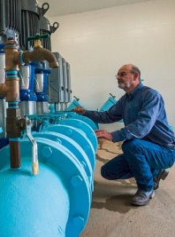
Adding Non-Traditional Subscribers:
Independent Public Utilities
Background
Covington Water District interested in MBP subscription
MBP has utility services involved currently through jurisdictions’ development departments – Bellevue, Kirkland, etc.
Things to Consider
Different organizational structure and focus; no legislative body
Separately elected board; still governed by public records laws
MBP Fee structure still applicable
Management and other committee participation still applicable
Covington does not have a backend permitting system
Next Steps
Covington is reviewing some other solutions, but MBP is popular

Slide 13

Alliance Staff Changes and Ideas
Current SLA Staffing Resources
SLA defines hybrid service model with some services are hourly while others are service-based
SLA core team hours include work done by business analysts, developers, a project manager and a system tester
Background Considerations
SLA defines work and hours and Bellevue selects resources
Currently, most SLA resources are booked for 2019 work plan
Additional business analysis requires more resources
Any programming outside 2019 plan needs resources or new plan
Executive Director Recommendations
More staff needed for new business analysis or programming work
Interns could provide possible one-time resource

Slide 14

Visioning Work and Workshop Framing
Recommended Agenda
Historical Summary 45 minutes
Current Trends 45 minutes
New Challenges 60 minutes
Pathway Options 120 minutes
Next Steps 30 minutes
Options for Length
One 7-hour day (w/ lunch) or Two 3-hour days
Location Options
Government Facility or Private Venue
Timing Options
April and May for June action, or later (summer)
Facilitation Options
Executive Director, or independent facilitation ($)

Slide 15

B&O Tax System of Record Opportunity
State Mandate Considerations
By July 2020, all Washington cities must choose to use either the State B&O tax system or FileLocal.
Bellevue developed PRAXIS as a backend system for its B&O related functions within the City of Bellevue, and the data from PRAXIS is then sent to FileLocal.
Bellevue has signed software sharing agreements with multiple jurisdictions at nominal cost and retains the IP rights to the software.
Some jurisdictions have hired additional consultants to integrate and expand PRAXIS.
Some jurisdictions either using PRAXIS or considering it expressed a desire for additional ongoing support, software development and integration services.
Does the Alliance want to consider developing its own system or collaborating with Bellevue to provide PRAXIS as a new service line?

Slide 16
Adjourn
Summarize Decisions and Action Items
1.
2.
3.
4.
5.
Feedback ??
Next Meeting – Mandatory Attendance
June 21, 2019 – Kirkland City Hall

