Slide 1
eCityGov Alliance
Executive Board Meeting
February 15, 2019

Slide 2
Agenda
Adoption of November meeting minutes
Executive Director January Update Report (Monthly)
RESOLUTION to adopt amended Management Committee Administrative Policies
RESOLUTION to adopt Woodway subscriber agreement
Executive Board Leadership Discussion
2018 Year End Budget Report
2019 DRAFT Work Plan
Executive Director Observations
Historical Permit Data
Business Development Example

Slide 3
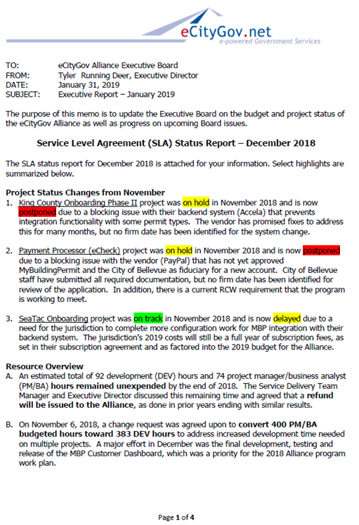
Executive Director Monthly Report
January 2019
Update Memo Sections
Service Level Agreement (SLA) Status Report – December 2018
Budget Monitoring Report – November 2018
Executive Board Planning – January 2019
Alliance Committee Activities – January 2019
Business Development – January 2019
General Activities – January 2019
Feedback ??

Slide 4

Amended Management Committee Administrative Policies
Main Reasons for Changes
Confusing order of policy sections
Some out of date references
Other general cleanup of language
Changes of Note
Added a goal (4.b.vii) to monitor State code and propose changes
Allowed exception for required MBP permit review module usage
Added Subscriber appointments per recent ILA ByLaw changes
Added presentation to and approval by Executive Board of Management Committee annual work plan
Removed both active Management Committee member reduced fee and non-active Management Committee member increased fee
Removed required monitoring of business & professional licenses
Removed online submittal requirements that are now available on MBP

Slide 5
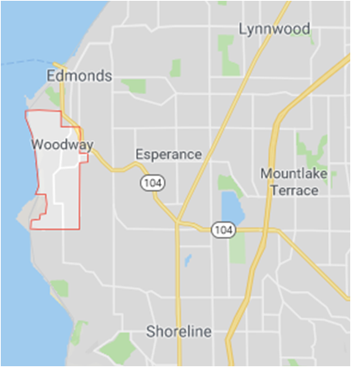
MBP Subscriber Agreement with the
Town of Woodway
Jurisdiction Statistics
Within Snohomish County
Incorporated in 1958 to protect heavy forest area
2010 US Census reported 1,307 residents
Average annual permit revenue is approximately $73,000
http://www.townofwoodway.com/
Items of Note
Updated language to incorporate ByLaw changes
Updated language to incorporate Financial Policy changes
Removed legacy Technology Use attachment
Applied current minimum onboarding fee
MBP Annual fee is the smallest of all current subscribers

Slide 6

Executive Board Leadership Discussion
Current Officers
Chair Aaron Antin, City of Sammamish
Vice-Chair P J Rodriguez, City of Snoqualmie
Treasurer Tracey Dunlap, City of Kirkland
Executive Board Officer Rotation
As voted and approved at the Executive Board meeting February 24, 2017, with each term starting on May 1.
Principal | Chair | Vice Chair | Treasurer
Kirkland | 2016 – 2018 | 2020 – 2022 | 2018 – 2020
Sammamish | 2018 – 2020 | 2022 – 2024 | 2020 – 2022
Snoqualmie | 2020 –2022 | 2024 – 2026 | 2017 - 2018
Bellevue | 2022 – 2024 | 2026 – 2028
Kenmore | 2024 – 2026 | 2017 - 2018 | 2022 – 2024
Issaquah | 2026 – 2028 | 2018 – 2020 | 2024 – 2026
Legend | Not Allowed | Current | Exception

Slide 7
Executive Board Leadership Discussion, cont’d
Relevant ByLaw Language
Section 5 Officers
  5.6 Vice-Chair. “The Vice-Chair shall perform the duties of the Chair in the absence of the Chair … shall have all the powers of and … all the restrictions …”
  5.11 Vacancies. “Vacancies in any office … may be filled by the Board at any regular or special meeting … subject to the notice provisions set forth in Section 4.4 through 4.16 …”
Executive Board Options
Option 1 – No Action
Option 2A – Advance and Lengthen the Officer Schedule
Option 2B – Advance and Reset the Officer Schedule
Option 3 – Other, Board Recommended Path

Slide 8
Executive Board Leadership Discussion, cont’d
Executive Board Options
Option 1 – No Action
  Effect: Allow current ByLaws to have effect from now through April 2020, which allow the Vice-Chair to function as Chair.
  Risks: The Vice-Chair will be required to attend every meeting through April 2020 to perform the duties of the Chair, otherwise a resolution will be required at the beginning of each meeting to grant the intended Board member to serve as Chair for that meeting.
  Actions Required: None
Option 2A – Advance and Lengthen the Officer Schedule
  Effect: In February 2017 the Board approved an officer rotation schedule. The Board could vote for that schedule to begin earlier and the terms scheduled to begin in 2020 would serve a 3rd year.
  Risks: Three-year terms might be long (fatigue, other duties, etc.).
  Actions Required: The Board would need to vote to amend the current officer rotation schedule.

Slide 9
Executive Board Leadership Discussion, cont’d
Executive Board Options
Option 2B – Advance and Reset the Officer Schedule
  Effect: In February 2017 the Board approved an officer rotation schedule. The Board could vote to reset that schedule to instead begin and end on odd years, instead of its current even years.
  Risks: Possible conflicts with expected timing (other duties, etc.).
  Actions Required: The Board would need to vote to amend the current officer rotation schedule.
Option 3 – Other, Board Recommended Path
  Effect: TBD
  Risks: TBD
  Actions Required: The Board would need to vote to amend the current officer rotation schedule.
Recommendation
Option 2B – Advance and Reset the Officer Schedule

Slide 10

2018 Year-end Budget Report
 |  | Approved Budget | Budget Actuals | Difference | % Change
Revenues | MBP | $1,362,959 | $1,398,981 | $36,023 | 3%
 | NWP | $121,964 | $122,494 | $529 | 0.4%
 | GJT | $116,965 | $112,295 | ($4,671) | (4%)
 | SPP | ($66,430) | ($66,430) | $0 | 0%
 | Total | $1,535,458 | $1,567,340 | $31,881 | 2%
Expenses | MBP | $1,171,466 | $1,117,588 | ($53,878) | (5%)
 | NWP | $93,750 | $68,919 | ($24,831) | (26%)
 | GJT | $85,750 | $69,653 | ($16,097) | (19%)
 | SPP | $0 | $0 | $0 | 0%
 | Total | $1,284,536 | $1,189,730 | ($94,806) | (7%)

Slide 11
2018 Year-end Budget Report, cont’d
Fund Balance |  | Starting Fund Balance | Fund Balance Actuals |  | Difference |  | % Change
 | MBP | $941,817 | $1,031,717 |  | $89,900 |  | 10%
 | NWP | $83,826 | $109,186 |  | $25,360 |  | 30%
 | GJT | $86,827 | $98,253 |  | $11,426 |  | 13%
 | Total | $1,112,469
Reserves |  | Minimum Budget % | Minimum Amount | Current Amount |  | Unreserved Amount
 | MBP | 50% | $585,733 | $1,031,717 |  | $445,985
 | NWP | 10% | $9,375 | $109,186 |  | $99,811
 | GJT | 10% | $8,575 | $98,253 |  | $89,678
 | Total |  |  |  |  | $666,504

Slide 12

2019 Alliance Program Work Plan
Alliance Work Approach
Ongoing Operations and Maintenance
Minor Fixes and Requests (Bugs, Tickets, etc.)
Major Projects (Larger Fixes and Enhancements)
Current Product Work Effort
Major Projects
Usually more than 40 hours of development staff time
Recommended by Program Team
Approved by Management Committee
Added to Annual Work Plan
 | MBP | GJT | NWP
Estimated Available Staff Time | 93% | 5% | 2%

Slide 13
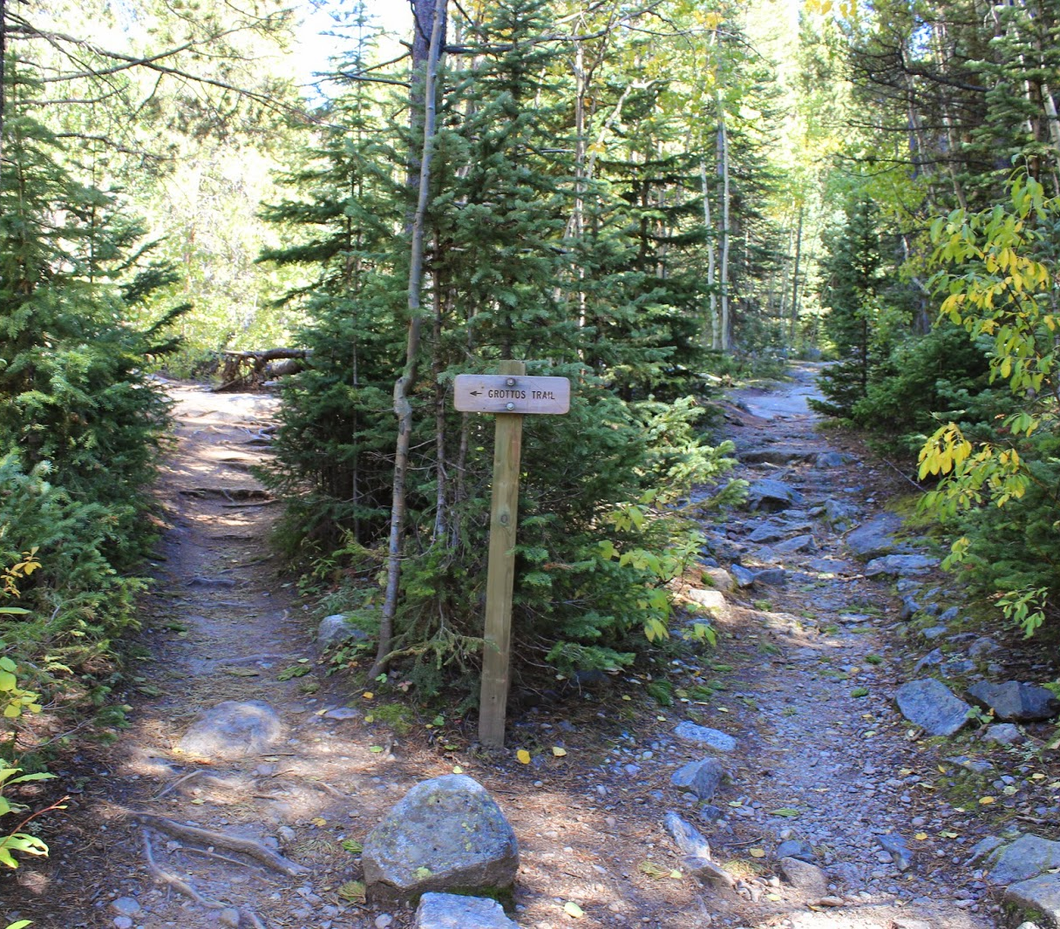
Executive Director Observations
Opportunities Abound
Grow typical customers with exiting products
Expand to new customers with existing products
Develop new features of current products
Develop entirely new products
Partner with other providers
Risks
Competitors are catching up to us!
Unknown technology trends
Investment needed to develop any new areas
Any new offerings will be untested
Any partnerships come with less control
Split between small and large customer needs

Slide 14

Historical Data
Partners and Subscribers
Definite growth, especially last two years
Some dynamic membership activity
Some strengthened relationships
Strong and supportive core of membership
Waning interest in some products
Permits and Revenues
Definite growth, especially last two years
Expanded product features
Costs have reduced for membership
Plan review product type has greatly increased
Non-MBP data needs updating

Slide 15
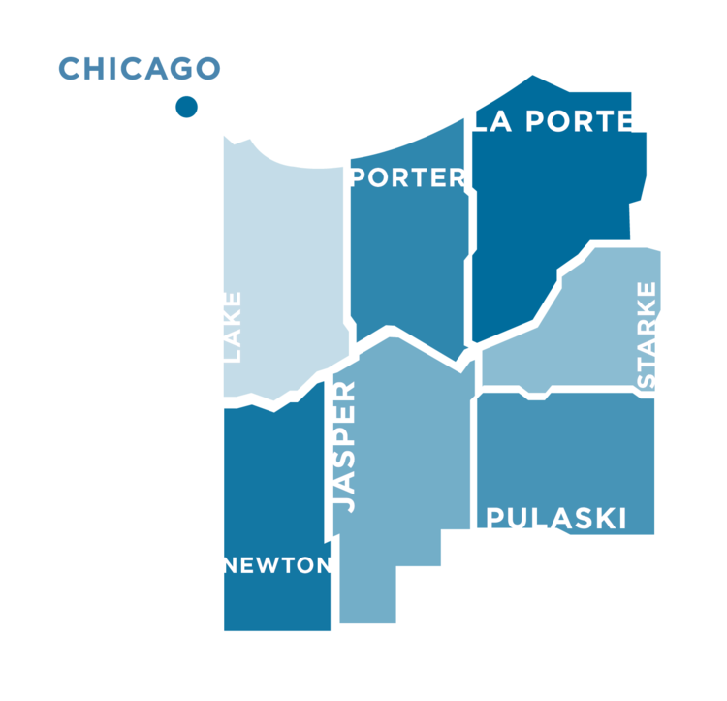
Business Development Example:
Northwest Indiana (NWI) Forum
Organizational Overview
The Forum’s mission is to increase the broad-based wealth in Northwest Indiana through economic development.
More than 60 investors that have contributed to the NWI Forum through grants and in-kind resources.
Board of Directors includes the region’s top corporate executives elected by the Forum membership from over 40 businesses.
Seven county governments are partners in the forum’s work.
Ignite the Region: A Regional Strategy for Economic Transformation
TIP STRATEGIES, INC., a private economic development consulting firm with offices in Austin and Seattle, developed the report.
Implementation Matrix Update - October 15, 2018
3.5. Establish an online permitting portal that encompasses multiple jurisdictions in the region.

Slide 16

The Road Ahead … and Behind
Reviewing the Past
Value the Founding Purpose and Goals
Assess Historical Data and Trends
Remember Learnings and Lessons To Date
Assessing the Current State
Analyze Product Performance
Collect and Summarize Customer Feedback
Review Current Building Trends
Planning for the Future
Study Service Industry Trends
Balance Potential Risks Versus Possible Gains
Prioritize Work Efforts
Estimate Available Resources

Slide 17
Adjourn
Summarize Decisions and Action Items
1.
2.
3.
4.
5.
Feedback ??
Next Meeting – Mandatory Attendance
April 19, 2019 – Kirkland City Hall

